Slide 1
Week 8: Word Embeddings

Slide 2
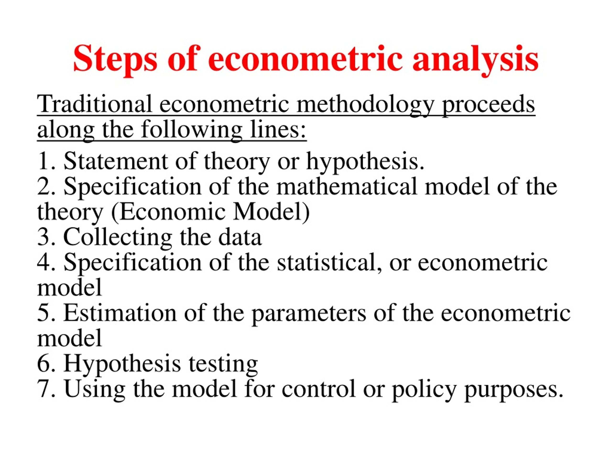

Slide 3
Collected Structured Data:
Y | x1 | x2 | x3 | … | xn
2.18356 | 0.210532 | 0.391946 | 0.28449 | 0.89728 | 0.25782
0.281732 | 0.125881 | 0.004438 | 0.417551 | 0.454522 | 0.460026
0.764441 | 0.142338 | 0.918924 | 0.744273 | 0.893245 | 0.344857
1.212201 | 0.698215 | 0.314777 | 0.133535 | 0.210025 | 0.20432
0.540826 | 0.938504 | 0.714209 | 0.740028 | 0.96168 | 0.346347
2.076274 | 0.421713 | 0.825697 | 0.783376 | 0.86697 | 0.434731
2.417431 | 0.396077 | 0.096879 | 0.599061 | 0.11812 | 0.6205
1.307566 | 0.91982 | 0.275524 | 0.47831 | 0.571489 | 0.982906
1.001136 | 0.454092 | 0.225018 | 0.952639 | 0.10315 | 0.908281
1.832001 | 0.949692 | 0.544448 | 0.722062 | 0.49695 | 0.826406
0.618659 | 0.230288 | 0.601155 | 0.287003 | 0.93571 | 0.244302
1.863663 | 0.339091 | 0.3605 | 0.903458 | 0.885787 | 0.269739
:

Slide 4

Current Statistical Techniques for Estimation
:
Econometric modelling: dependent (Target) and independent variables (Features):
M.odel: $Y_{i}=f(x_{1i},x_{2i}, . . . x_{ni}){+ e}_{i}$
Functional form of $f(x_{1i},x_{2i}, . . . x_{ni})$
Distributional assumptions of ${ e}_{i}$
ESTIMATION TECHNIQUES:
OLS
ML
BAYESIAN
NONPARAMETER
NB: if $x_{i}=Y_{−i}$ ➔ Autoregressive model (ARIMA) & if V$(e_{i}^{2} /{ e}_{−i}^{2})=$GARCH
What if we have text data as features/independent variables – can these techniques work?

Slide 5
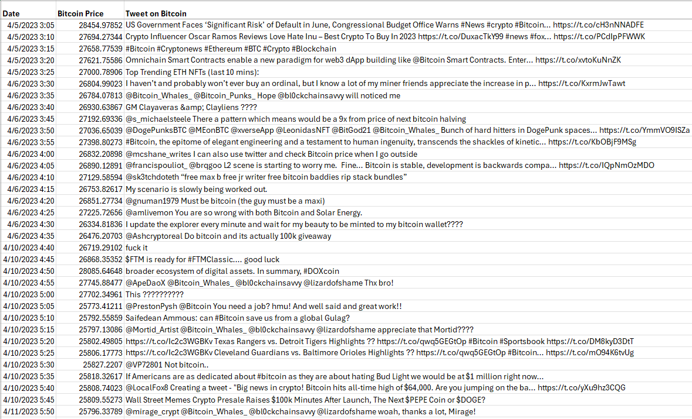
Text Data for CAPM/APT Model: Y: Bitcoin Price, Text Date: Tweets about bitcoin price movement

Slide 6
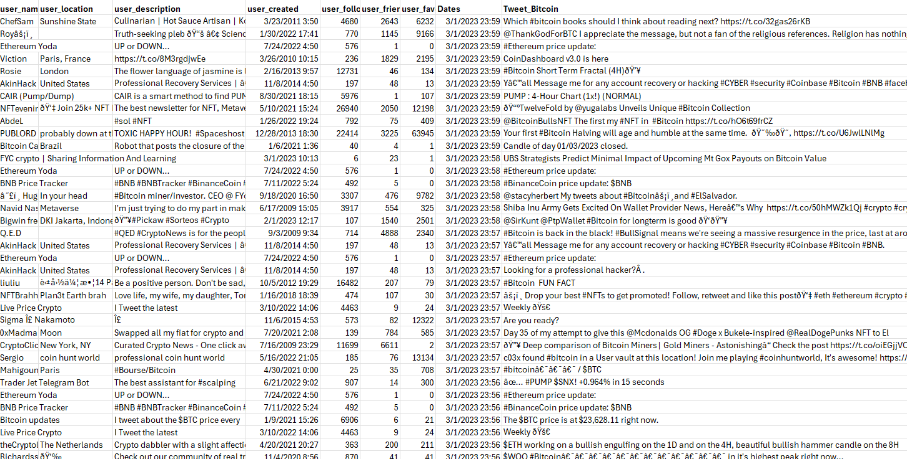
What if there is no given “target” Text: Tweets about Bitcoin
.

Slide 7
What if the text dataset is a Book! Text: “The Philosopher’s Stone: Harry Potter”
THE BOY WHO LIVED Mr. and Mrs. Dursley, of number four, Privet Drive, were proud to say that they were perfectly normal, thank you very much. They were the last people you’d expect to be involved in anything strange or mysterious, because they just didn’t hold with such nonsense. Mr. Dursley was the director of a firm called Grunnings, which made drills. He was a big, beefy man with hardly any neck, although he did have a very large mustache. Mrs. Dursley was thin and blonde and had nearly twice the usual amount of neck, which came in very useful as she spent so much of her time craning over garden fences, spying on the neighbors. The Dursley s had a small son called Dudley and in their opinion there was no finer boy anywhere. The Dursleys had everything they wanted, but they also had a secret, and their greatest fear was that somebody would discover it. They didn’t think they could bear it if anyone found out about the Potters. Mrs. Potter was Mrs. Dursley’s sister, but they hadn’t Page | 2 Harry Potter and the Philosophers Stone - J.K. Rowling met for several years; in fact, Mrs. Dursley pretended she didn’t have a sister, because her sister and her good-for-nothing husband were as unDursleyish as it was possible to be. The Dursleys shuddered to think what the neighbors would say if the Potters arrived in the street. The Dursleys knew that the Potters had a small son, too, but they had never even seen him. This boy was another good reason for keeping the Potters away; they didn’t want Dudley mixing with a child like that. When Mr. and Mrs. Dursley woke up on the dull, gray Tuesday our story starts, there was nothing about the cloudy sky outside to suggest that strange and mysterious things would soon be happening all over the country. Mr. Dursley hummed as he picked out his most boring tie for work, and Mrs. Dursley gossiped away happily as she wrestled a screaming Dudley into his high chair. None of them noticed a large, tawny owl flutter past the window. At half past eight, Mr. Dursley picked up his briefcase, pecked Mrs. Dursley on the cheek, and tried to kiss Dudley good-bye but missed, because Dudley was now having a tantrum and throwing his cereal at the walls. “Little tyke,” chortled Mr. Dursley as he left the house. He got into his car and backed out of number four’s drive. It was on the corner of the street that he noticed the first sign of something peculiar — a cat reading a map. For a second, Mr. Dursley didn’t realize what he had seen — then he jerked his head around to look again. There was a tabby cat standing on the corner of Privet Drive, but there wasn’t a map in sight. What could he have been thinking of? It must have been a trick of the light. Mr. Dursley blinked and stared at Page | 3 Harry Potter and the Philosophers Stone - J.K. Rowling the cat. It stared back. As Mr. Dursley drove around the corner and up the road, he watched the cat in his mirror. It was now reading the sign that said Privet Drive — no, looking at the sign; cats couldn’t read maps or signs. Mr. Dursley gave himself a little shake and put the cat out of his mind. As he drove toward town he thought of nothing except a large order of drills he was hoping to get that day. But on the edge of town, drills were driven out of his mind by something else. As he sat in the usual morning traffic jam, he couldn’t help noticing that there seemed to be a lot of strangely dressed people about. People in cloaks. Mr. Dursley couldn’t bear people who dressed in funny clothes — the getups you saw on young people! He supposed this was some stupid new fashion. He drummed his fingers on the steering wheel and his eyes fell on a huddle of these weirdos standing quite close by. They were whispering excitedly together. Mr. Dursley was enraged to see that a couple of them weren’t young at all; why, that man had to be older than he was, and wearing an emerald-green cloak! The nerve of him! But then it struck Mr. Dursley that this was probably some silly stunt — these people were obviously collecting for something ... yes, that would be it. The traffic moved on and a few minutes later, Mr. Dursley arrived in the Grunnings parking lot, his mind back on drills. Mr. Dursley always sat with his back to the window in his office on the ninth floor. If he hadn’t, he might have found it harder to concentrate on drills that morning. He didn’t see the owls swooping past in broad daylight, though people down in the street did; they pointed and gazed open-mouthed as owl after owl sped overhead. Most of them had never seen an owl even at nighttime. Mr. Dursley, however, had a perfectly normal, owl-free morning. He yelled at five different people. He made several important telephone Page | 4 Harry Potter and the Philosophers Stone - J.K. Rowling calls and shouted a bit more. He was in a very good mood until lunchtime, when he thought he’d stretch his legs and walk across the road to buy himself a bun from the bakery. He’d forgotten all about the people in cloaks until he passed a group of them next to the baker’s. He eyed them angrily as he passed. He didn’t know why, but they made him uneasy. This bunch were whispering excitedly, too, and he couldn’t see a single collecting tin. It was on his way back past them, clutching a large doughnut in a bag, that he caught a few words of what they were saying. “The Potters, that’s right, that’s what I heard — ” “ — yes, their son, Harry — ” Mr. Dursley stopped dead. Fear flooded him. He looked back at the whisperers as if he wanted to say something to them, but thought better of it. He dashed back across the road, hurried up to his office, snapped at his secretary not to disturb him, seized his telephone, and had almost finished dialing his home number when he changed his mind. He put the receiver back down and stroked his mustache, thinking ... no, he was being stupid. Potter wasn’t such an unusual name. He was sure there were lots of people called Potter who had a son called Harry. Come to think of it, he wasn’t even sure his nephew was called Harry. He’d never even seen the boy. It might have been Harvey. Or Harold. There was no point in worrying Mrs. Dursley; she always got so upset at any mention of her sister. He didn’t blame her — if he’d had a sister like that ... but all the same, those people in cloaks ... Page | 5 Harry Potter and the Philosophers Stone - J.K. Rowling He found it a lot harder to concentrate on drills that afternoon and when he left the building at five o’clock, he was still so worried that he walked straight into someone just outside the door. “Sorry,” he grunted, as the tiny old man stumbled and almost fell. It was a few seconds before Mr. Dursley realized that the man was wearing a violet cloak. He didn’t seem at all upset at being almost knocked to the ground. On the contrary, his face split into a wide smile and he said in a squeaky voice that made passersby stare, “Don’t be sorry, my dear sir, for nothing could upset me today! Rejoice, for You- Know-Who has gone at last! Even Muggles like yourself should be celebrating, this happy, happy day!” And the old man hugged Mr. Dursley around the middle and walked off. Mr. Dursley stood rooted to the spot. He had been hugged by a complete stranger. He also thought he had been called a Muggle, whatever that was. He was rattled. He hurried to his car and set off for home, hoping he was imagining things, which he had never hoped before, because he didn’t approve of imagination. As he pulled into the driveway of number four, the first thing he saw — and it didn’t improve his mood — was the tabby cat he’d spotted that morning. It was now sitting on his garden wall. He was sure it was the same one; it had the same markings around its eyes. “Shoo!” said Mr. Dursley loudly. The cat didn’t move. It just gave him a stern look. Was this normal cat behavior? Mr. Dursley wondered. Trying to pull himself together, he let himself into the Page | 6 Harry Potter and the Philosophers Stone - J.K. Rowling

Slide 8
TEXT VECTORIZATION
Text analytics deals with the gathering, storing, and mining of textual information to impower businesses to make efficient decisions.
Today: in the era of Big Data: the production of non-numerical data has significantly increased thanks to the progress in computer automation.
For example: 4 petabytes of data per day are produced by Facebook most of which are textual data
Machine Learning and Deep Learning cannot accept text, we must convert it to numeric representation.
In NLP, there are techniques like Bag of Words, Term Frequency, TF-IDF, to convert text into numeric vectors.
These Bag of Words techniques do not represent the semantic relationship relationships between the texts in numeric form. They only vectorize the text!

Slide 9
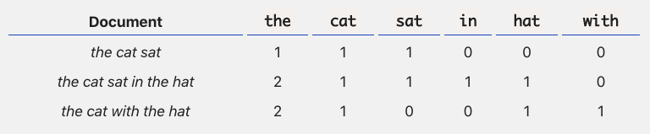
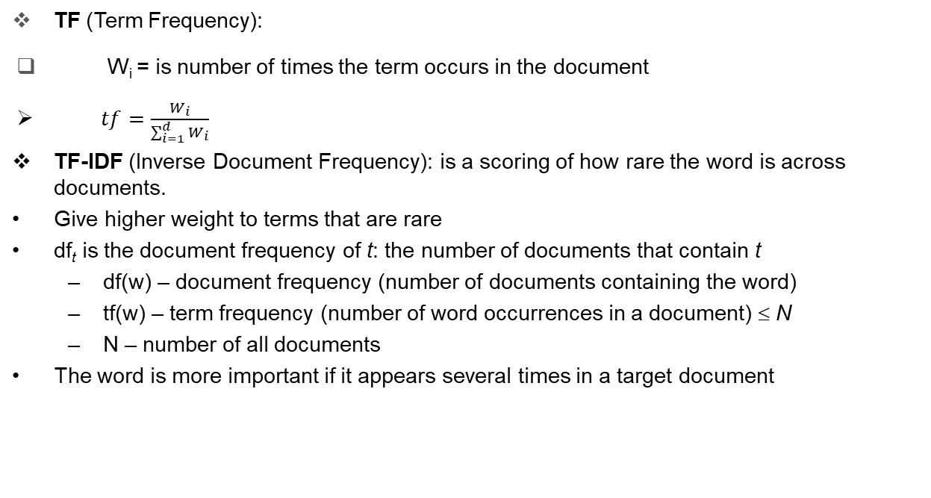
Document-Term Matrix of Bag of Words
TF (Term Frequency):
W_{i} = is number of times the term occurs in the document
$tf=\frac{W_{i}}{\sum_{i=1}^{d}{W_{i}}}$
TF-IDF (Inverse Document Frequency): is a scoring of how rare the word is across documents.
Give higher weight to terms that are rare
df_{t} is the document frequency of t: the number of documents that contain t
df(w) – document frequency (number of documents containing the word)
tf(w) – term frequency (number of word occurrences in a document) ≤ N
N – number of all documents
The word is more important if it appears several times in a target document

Slide 10
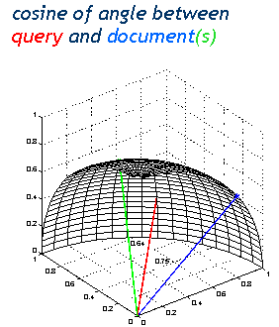
Similarity of Vecotrs
Dot product is the measure of similarity.
$$a=\left[a_{1},a_{2},…a_{d}\right],b=\left[b_{1},b_{2},…b_{d}\right]$$
$$a^{T}b=a.b=a_{1}b_{1}+a_{2}b_{2}\text{+…+ }a_{d}b_{d}$$
$$=\left\|a\right\|\left\|b\right\|cos(θ)$$
If the vectors are perpendicular then the projection is zero
In text means two documents/sentence
does not Have any common words
$$θ$$

Slide 11
Document – Word Representation: One-hot Vectors
Words as discrete units.
Represent as one-hot vectors
Example:
Document1: the king is the leader of the society
Document2: the queen is a wife and mother
## collect all unique words {the, king, is, leader, of, society, queen,
Example Let our lexicon be: {king, queen, man, woman} => (key words: column heads)
king [1, 0, 0, 0] ➔ king appears 1 in first doc, 0 in 2nd, 0 in third, 0 in fourth
queen [0, 1, 0, 0] ➔queen appears 0 times in the first doc, 1 in 2nd, 0 in the third doc, 0 in the fourth doc
man [0, 0, 1, 0] …
woman [0, 0, 0, 1]…
NB: these are (normalised vectors!) in a math sense!
NB: here column headings are words appearing in all docs. Row heading show the docs (first row for the 1st doc, 2nd row for the 2nd doc, etc)
What would the dot product of the king vector and queen vector be?
||[1,0,0,0] * [0,1,0,0]||=?

Slide 12
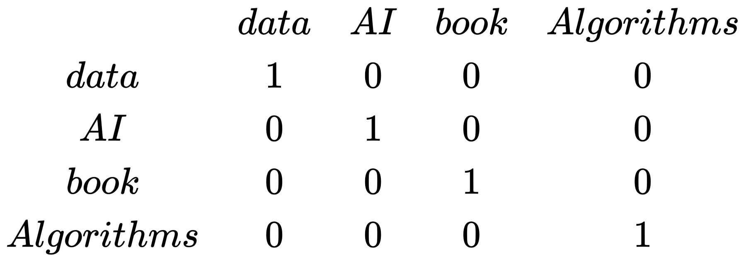
One-Hot Encoding
One-hot encoding is the binary sparse vector representation of text.
In this encoding, the resulting binary vector is all zero-value except at the position or index of the token where it is one.

Slide 13
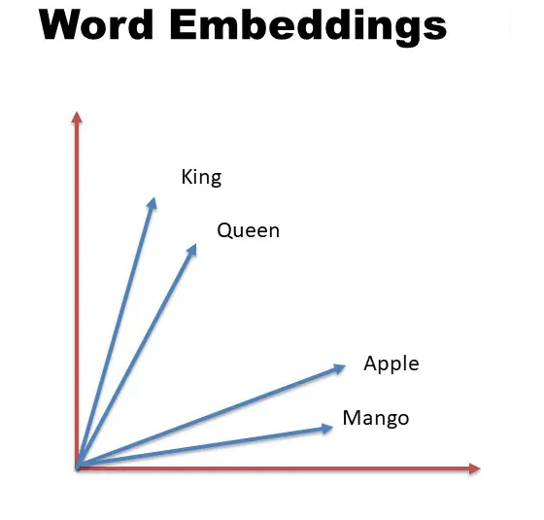
What are “Word Embeddings”
Word Embeddings are numeric vector representations of text that also maintain the semantic and contextual relationships within the words in the text corpus.
In such representation, the words that have stronger semantic relationships are closer to each other in the vector space.

Slide 14
One-hot vs. Embedding
Traditional Method - Bag of Words Model | Word Embeddings
Uses one hot encoding Each word in the vocabulary is represented by one bit position in a HUGE vector. For example, if we have a vocabulary of 10000 words, and “Hello” is the 4th word in the dictionary, it would be represented by: 0 0 0 1 0 0 . . . . . . . 0 0 0 0 Context information is not utilized | Stores each word in as a point in space, where it is represented by a vector of fixed number of dimensions (generally 300) Unsupervised, built just by reading huge corpus For example, “Hello” might be represented as : [0.4, -0.11, 0.55, 0.3 . . . 0.1, 0.02] Dimensions are basically projections along different axes, more of a mathematical concept. Context information is utilized

Slide 15
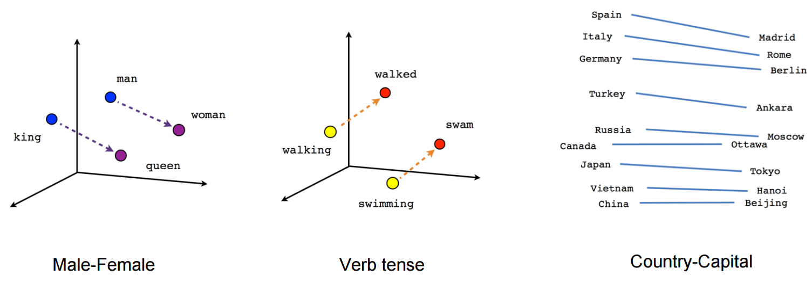
Embedding

Slide 16
How word embedding work?
Text Similarity:
Word Embedding is based on the concept of similar context have similar embedding or Similar words occur in similar contexts. They are exchangeable.
Vec(dog bites man)=(0.2,-0.3,1.5)
Sentence similar in meaning should be close to this embedding.

Slide 17
Word Embedding Methods
Co-occurrence Matrix
SVD
word2vec (Google)
[Global Vector Representations (GloVe) (Stanford)]

Slide 18
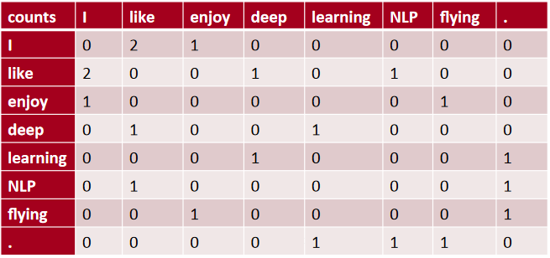
Co-occurrence Matrix
Corpus = {“I like deep learning”
“I like NLP”
“I enjoy flying”}
Context = previous word and next word
Notes:
Raw/column=> key words/lexicon||| interpretation of the Table:: first raw:: in the document where ‘I’ appear; the next word is “like” . The previous word is 0.
In the document(raw) “like” appears the previous word is “I” appears twice, the next word appears..
With this matrix we can manipulate words. For example enjoy +flying =?; deep*NLP-I=?

Slide 19
Issue with Co-occurrence Matrix
increase in size with vocabulary
very high dimensional
sparsity issues
Solution 1: dimensionality reduction (see SVD – week 7)
Store most of the information in a fixed, small number of dimensions: a dense vector.
Solution 2: using Word2vec Embedding method/algorithm

Slide 20
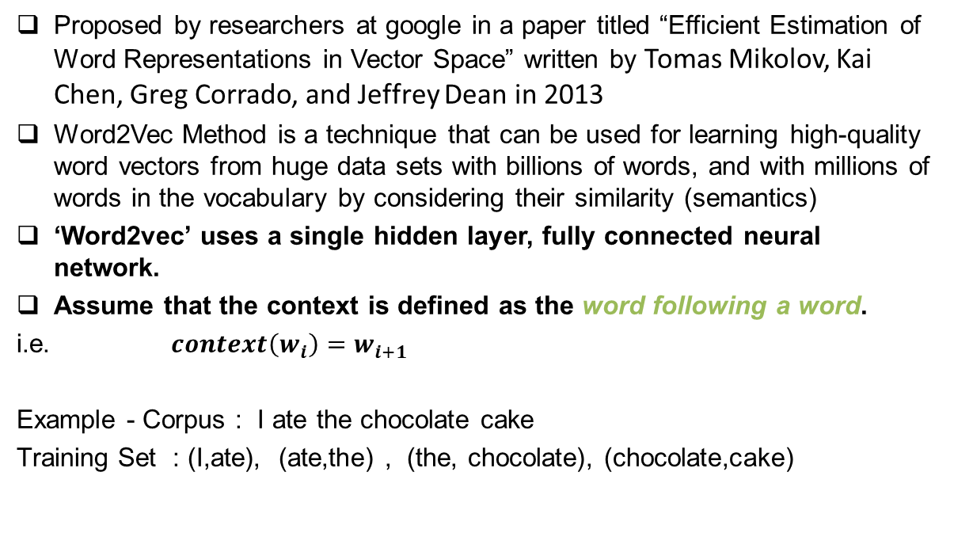
Word2Vec Model
Proposed by researchers at google in a paper titled “Efficient Estimation of Word Representations in Vector Space” written by Tomas Mikolov, Kai Chen, Greg Corrado, and Jeffrey Dean in 2013
Word2Vec Method is a technique that can be used for learning high-quality word vectors from huge data sets with billions of words, and with millions of words in the vocabulary by considering their similarity (semantics)
‘Word2vec’ uses a single hidden layer, fully connected neural network.
Assume that the context is defined as the word following a word.
i.e. $context\left(w_{i}\right)=w_{i+1}$
Example - Corpus : I ate the chocolate cake
Training Set : (I,ate), (ate,the) , (the, chocolate), (chocolate,cake)
Notes:
In the co-occurent matrix the context was: “previous word, next word” here the context is: “word following word”

Slide 21
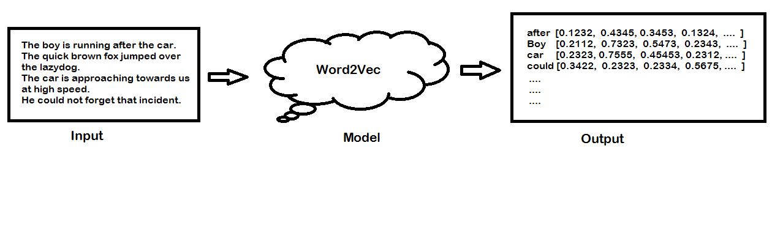
Word2Vec Architecture: Model=Neural Network
Word2Vec Example:

Slide 22
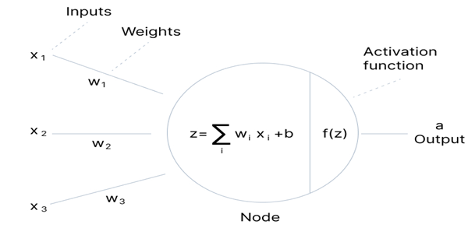
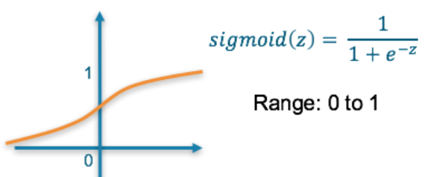
Reminder: Neural Network Basics
The building block of a Neural Network is a perceptron:
Activation Function f(z):
Notes:
The original perceptron did not have an activation function, it used a step function to output either 1 or 0

Slide 23
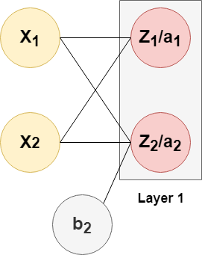
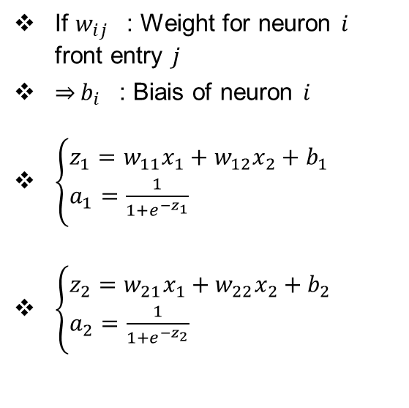
Architecture Neural Network
.
If $w_{ij }$: Weight for neuron $i$ front entry $j$
$\overset{⇒}{}b_{i }$ : Biais of neuron $i$
$\left\{\begin{aligned}&z_{1}=w_{11}x_{1}+w_{12}x_{2}+b_{1} \\ &a_{1}=\frac{1}{1+e^{−z_{1}}}\end{aligned}\right.$
$\left\{\begin{aligned}&z_{2}=w_{21}x_{1}+w_{22}x_{2}+b_{2} \\ &a_{2}=\frac{1}{1+e^{−z_{2}}}\end{aligned}\right.$

Slide 24
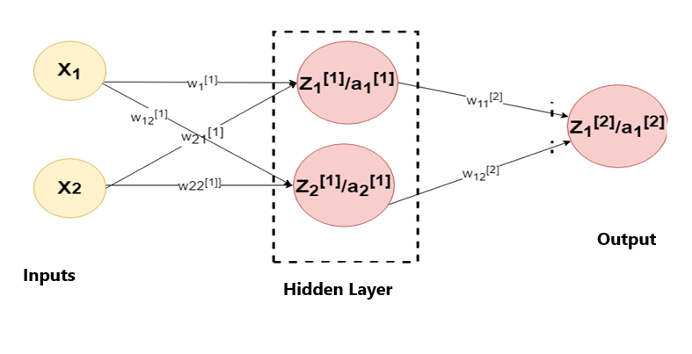

.
$w_{11}^{[2]}$ : Weight for $Z_{1}^{[2]}$ coming from $a_{1}^{[1]}$
$w_{12}^{[2]}$ : Weight for $Z_{1}^{[2]}$ coming from $a_{2}^{[1]}$
$\left\{\begin{aligned}&Z_{1}^{[2]}=w_{11}^{[2]}a_{1}^{[1]}+w_{12}^{[2]}a_{2}^{[1]}+b_{1}^{[2]} \\ &a_{1}^{[2]}=\frac{1}{1+e^{−{Z_{1}}^{[2]}}}\end{aligned}\right.$

Slide 25
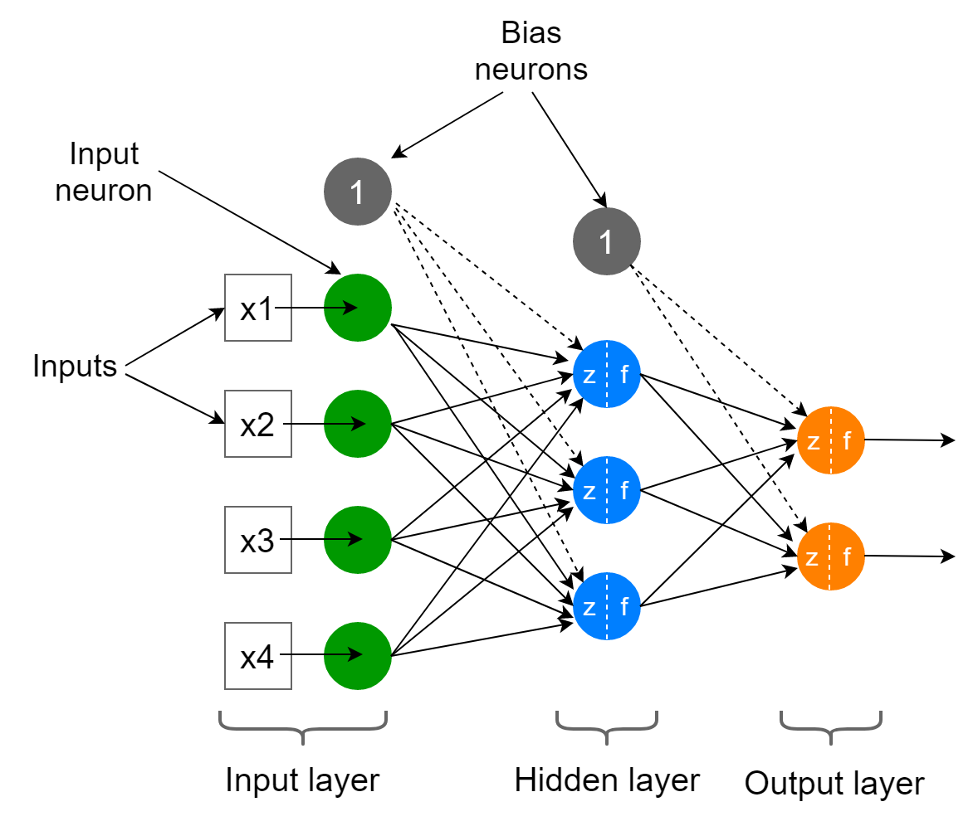
One Hidden Layer Network
Each neuron has 2 parts: summation and activation function
The list of activation function is provided above:

Slide 26
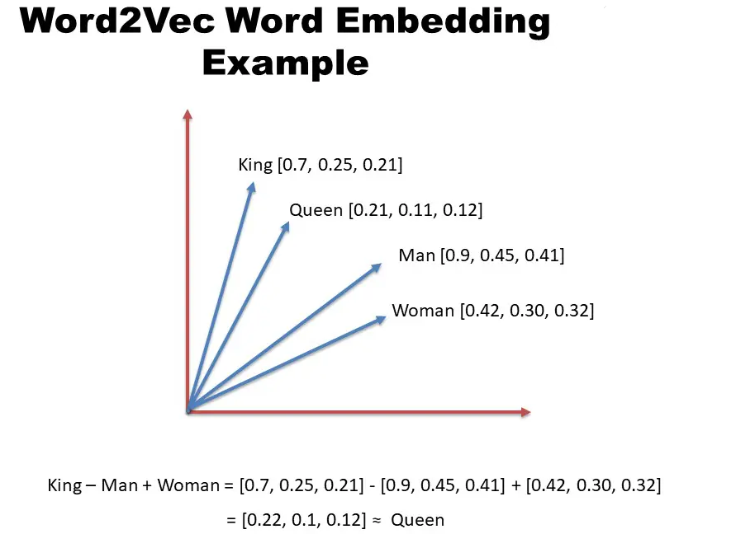
Word2Vec Model
The word2vec model can create numeric vector representations of words from the training text corpus that maintains the semantic and syntactic relationship.
A very famous example of how word2vec preserves the semantics is when you subtract the word Man from King and add Woman it gives you Queen as one of the closest results.
King – Man + Woman ≈ Queen

Slide 27
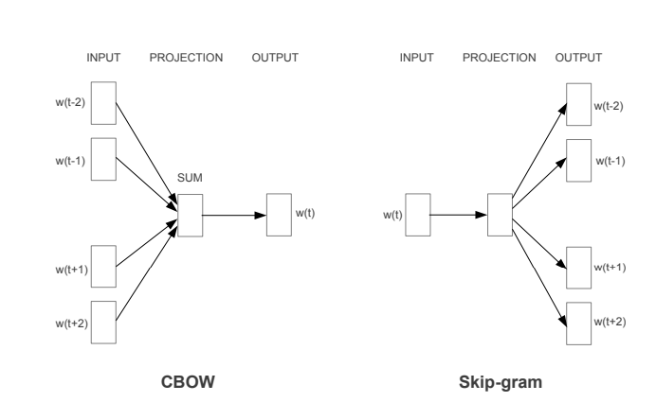
Word2Vec Architectures: Continuous Bag of Words (CBOW) and Skip-Gram.

Slide 28
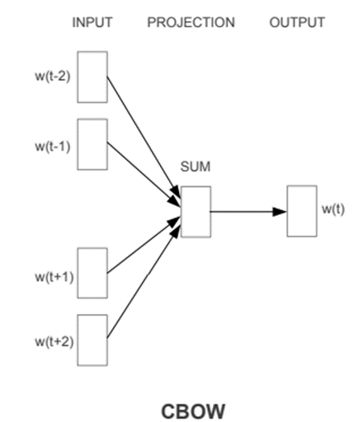
Continuous Bag of Words (CBOW) Model
The CBOW model predicts the current word from the surrounding context words.
The length of the surrounding context word is the window size that is a tunable hyperparameter.
The model is trained by a single hidden layer Neural Network.
Once the Neural Network is trained, it results in the vector representation of the words in the training corpus.
The size of the vector is also a hyperparameter that we can accordingly choose to produce the best possible results.

Slide 29
CBOW Implementation
Build the corpus vocabulary
Build a CBOW (context, target) generator
Build the CBOW model architecture
Train the Model
Get Word Embeddings
Example: consider the following sentence:
➔<< Absa share price stumbled today>>

Slide 30
CBOW Implementation: example
CBOW procedure:
<< Absa share price stumbled today>>
Step 1: get the One-hot vectors
Step 2: determine the “window” parameter i.e. the number of words to make up the context (surrounding words) ➔ let’s say = 3
Step 3: predict the center word using one-layer Neural network using the following architecture:
 | Absa | share | price | stumbled | today
Absa | 1 | 0 | 0 | 0 | 0
share | 0 | 1 | 0 | 0 | 0
price | 0 | 0 | 1 | 0 | 0
stumbled | 0 | 0 | 0 | 1 | 0
today | 0 | 0 | 0 | 0 | 1

Slide 31
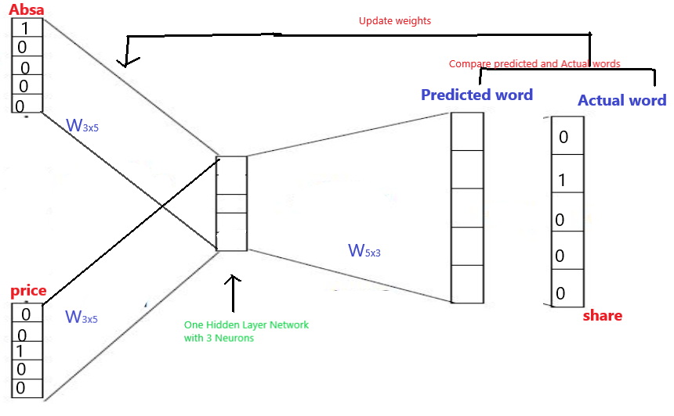

CBOW Implementation
bsa share price stumbled today
The CBOW model predicts the center word ($w_{t}:$share) using the context words ($w_{t−1} \&w_{t+1}$: Absa & price) one-hot encoding vectors
Absa=[1, 0, 0, 0, 0] and price=[0, 0, 1, 0, 0]:
Absa share price

Slide 32
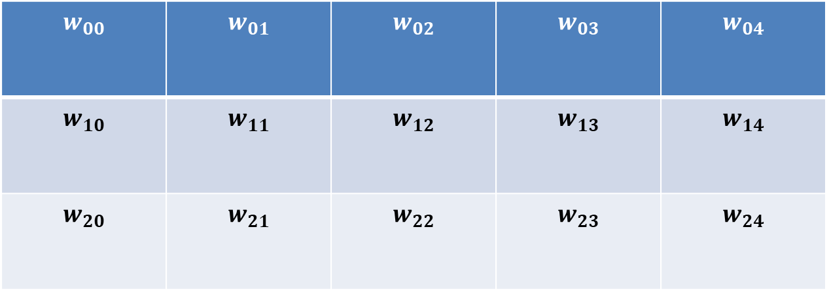
CBOW Implementation
After having adjusted the weights in the network (with backpropagation) the final weights are obtained:
$$w_{00}$$ | $$w_{01}$$ | $$w_{02}$$ | $$w_{03}$$ | $$w_{04}$$
$$w_{10}$$ | $$w_{11}$$ | $$w_{12}$$ | $$w_{13}$$ | $$w_{14}$$
$$w_{20}$$ | $$w_{21}$$ | $$w_{22}$$ | $$w_{23}$$ | $$w_{24}$$

Slide 33
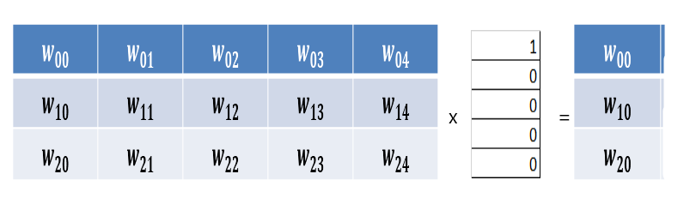
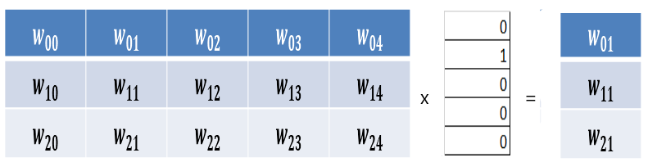
CBOW Implementation: Word Embeddings
The word embedding for the 1st word: “Absa” is obtained as follows:
The word embedding for the 2nd word: “share” is obtained as follows:
Similarly for the rest of the word. NB: sometimes we initialize the network with random weights rather than one-hot vec

Slide 34
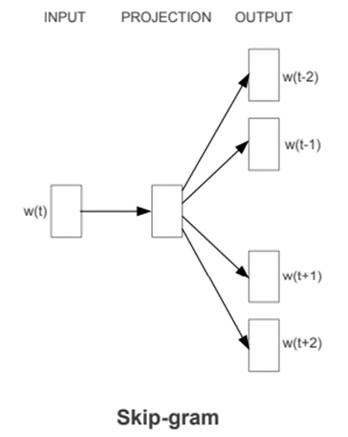
Skip-Gram Model
In the skip-gram model, the Neural Network is trained to predict the surrounding context words given the current word as input.
The Neural Network produces the vector representation of the words in the training corpus.

Slide 35
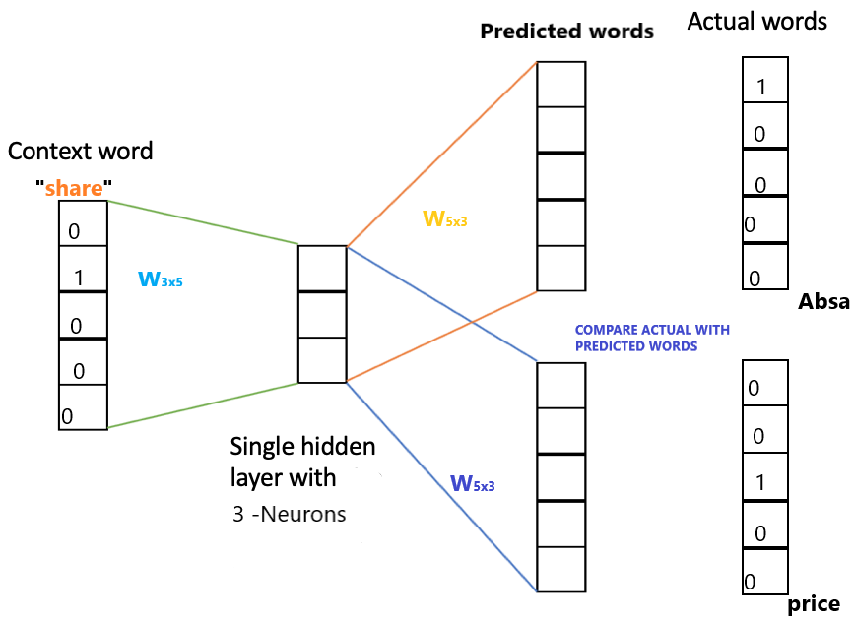

Skip-Gram Model Implementation
<<Absa share price stumbled today>>
The Ski[p-Gram model predicts the context words (words ($w_{t−1} \&w_{t+1}$: Absa & price) using the center word ($w_{t}:$share) one-hot encoding vector “share”=[0, 1, 0, 0, 0]:

Slide 36
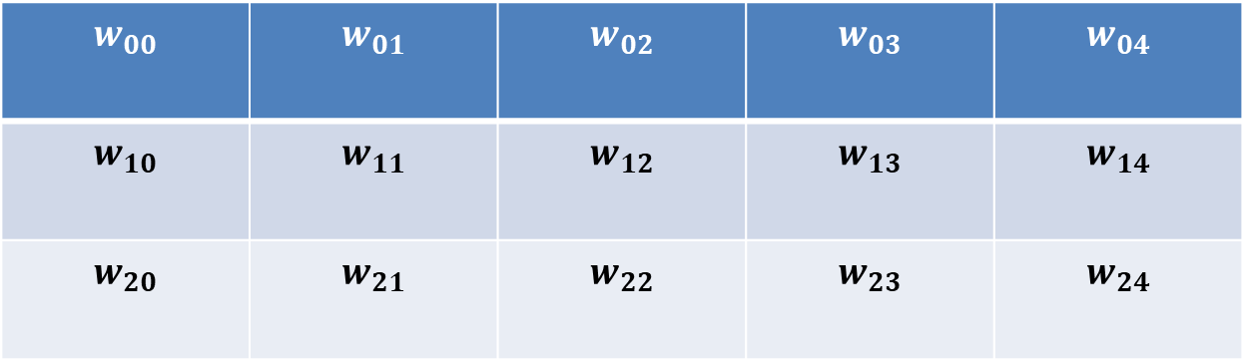
Skip-Gram Model Implementation
After having adjusted the weights in the network (with backpropagation) as above, the final weights are obtained:
$$w_{00}$$ | $$w_{01}$$ | $$w_{02}$$ | $$w_{03}$$ | $$w_{04}$$
$$w_{10}$$ | $$w_{11}$$ | $$w_{12}$$ | $$w_{13}$$ | $$w_{14}$$
$$w_{20}$$ | $$w_{21}$$ | $$w_{22}$$ | $$w_{23}$$ | $$w_{24}$$

Slide 37
Skip-Gram Model Implementation: Word Embeddings
The word embedding for the 1st word: “Absa” is obtained as follows:
The word embedding for the 2nd word: “share” is obtained as follows:
Similarly for the rest of the word. NB: sometimes we initialize the network with random weights rather than one-hot vec

Slide 38
The Difference between CBOW and Skip-Gram Word2Vec Models
CBOW model is trained by predicting the current word by giving the surrounding context words as input.
Skip-Gram model is trained by predicting the surrounding context words by providing the central word as input.
CBOW model is faster to train as compared to the Skip-Gram model.
CBOW model works well to represent the more frequently appearing words whereas Skip-Gram works better to represent less frequent rare words.

Slide 39
Example of Word Vectorization after Word2Vec estimation
Word embedding.
In this representation we can easily determine the correlation between Man and king or woman and queen
 | Man (5391) | Woman (9853) | King (4914) | Queen (7157) | Apple (456) | Orange (6257)
Gender | -1 | 1 | -0.95 | 0.97 | 0.00 | 0.01
Royal | 0.01 | 0.02 | 0.95 | 0.92 | -0.01 | 0.00
… | … | … | … | … | … | …
Food | 0.04 | 0.01 | 0.02 | 0.01 | 0.95 | 0.97

Slide 40
Example of Word representation
Word embedding can be visualized on the n-diagram matrix where the n is number of the features.
We will use TsNE library with PCA in 2 dim space:
Man
King
Woman
Queen

Slide 41


Example of Word embedding-similarity
$$similarity(\overset{U}{\overbrace{E_{woman}+E_{king}−{ E}_{man}}},\overset{V}{\overbrace{{ E}_{Queen}}})$$
$$Cosine similarity(U,V)=\frac{U^{T}V}{\left\|U\right\|.\left\|V\right\|}$$
$$θ$$

Slide 42

Example of Estimated Embedding-Matrix
$$\begin{matrix}\begin{matrix}⋯ & king & ⋯\end{matrix} & \begin{matrix}O_{4914} & E_{4914}\end{matrix} \\ \left[\begin{matrix}\begin{matrix}⋯ & e_{4914,1}\end{matrix} & ⋯ \\ \begin{matrix}\begin{matrix}\begin{matrix}⋮ \\ ⋮ \\ ⋮\end{matrix} \\ ⋯\end{matrix} & \begin{matrix}\begin{matrix}e_{4914,2} \\ ⋮ \\ e_{4914,n−1}\end{matrix} \\ e_{4914,n}\end{matrix}\end{matrix} & \begin{matrix}\begin{matrix}⋮ \\ ⋮ \\ ⋮\end{matrix} \\ ⋯\end{matrix}\end{matrix}\right]∗ & \left[\begin{matrix}\begin{matrix}0 \\ \begin{matrix}0 \\ ⋮\end{matrix}\end{matrix} \\ 1 \\ \begin{matrix}\begin{matrix}⋮ \\ 0\end{matrix} \\ 0\end{matrix}\end{matrix}\right]=\left[\begin{matrix}\begin{matrix}e_{4914,1} \\ e_{4914,2}\end{matrix} \\ ⋮ \\ \begin{matrix}e_{4914,n−1} \\ e_{4914,n}\end{matrix}\end{matrix}\right]\end{matrix}$$
Feature size
Corpus size

